Slide 1
Rate of Reaction
Lucarelli Chapter 14

Slide 2
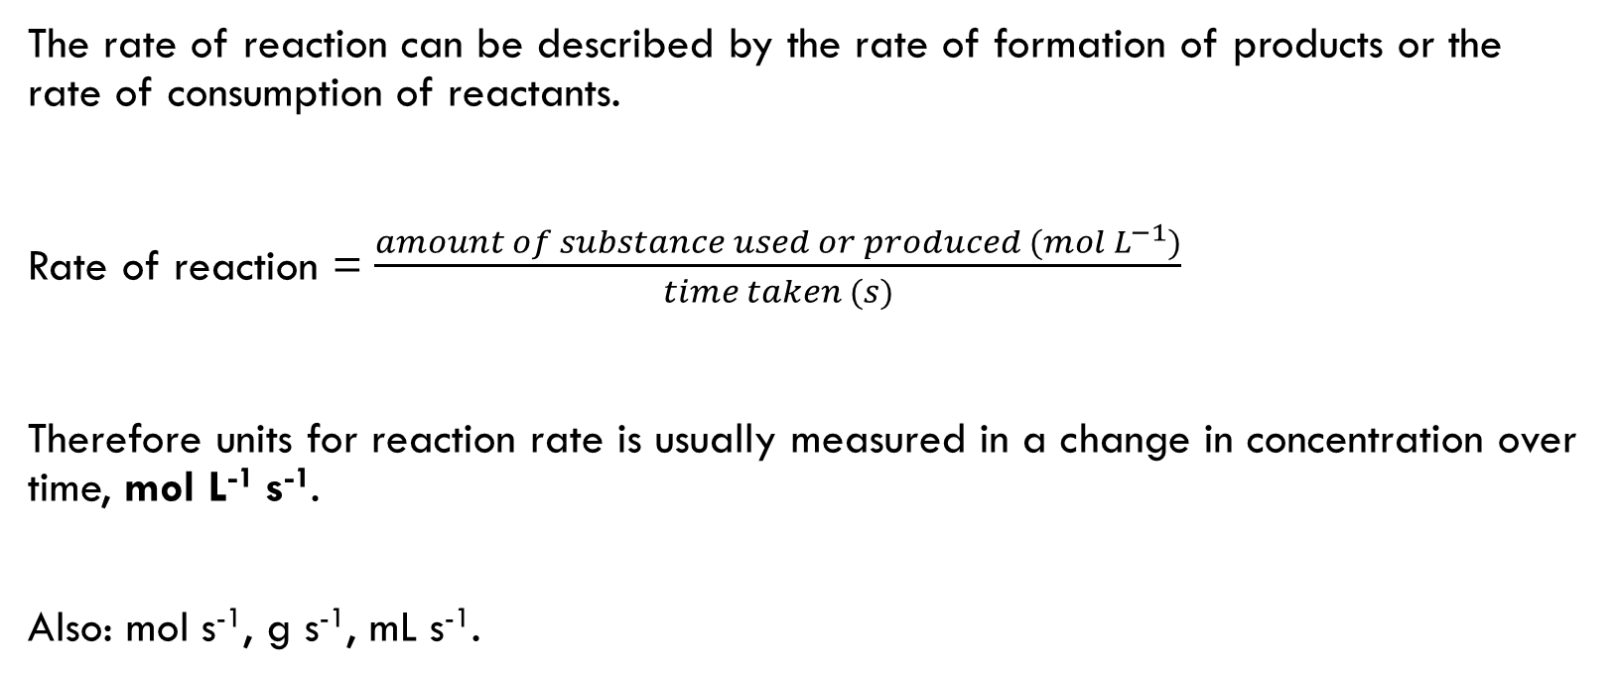
Reaction Rate
The rate of reaction can be described by the rate of formation of products or the rate of consumption of reactants.
Rate of reaction = $\frac{amount of substance used or produced ({mol L}^{−1})}{time taken (s)}$
Therefore units for reaction rate is usually measured in a change in concentration over time, mol L⁻¹ s⁻¹.
Also: mol s⁻¹, g s⁻¹, mL s⁻¹.

Slide 3
Collision theory
For a reaction to occur, all of the following conditions must be met:
Individual particles of the reacting substances must collide
The collision energy must be equal to or greater than a certain minimum amount known as the activation energy, E_{a}
The reacting particles must collide with a suitable orientation.
Transition state: original bonds are breaking and new bonds are
forming

Slide 4
Potential Energy Profile
See Lucarelli Chapter 14 for diagram

Slide 5
Factors affecting the rate of reaction
Concentration
Pressure
Temperature
Catalyst
Surface area

Slide 6
Concentration
Increase in concentration of reactants results in an increase in reaction rate.
CT: Higher concentration of reacting particles results in more frequent collisions and more frequent successful collisions.

Slide 7
Pressure
Raising the pressure, by reducing volume or adding more gas to a container, creates a greater concentration of reacting gas molecules. Greater rate of reaction.
CT: as per concentration

Slide 8
Temperature
Raising temperature of reagents increases reaction rate.
CT: At higher temperature, particles on average have a greater kinetic energy. This means that a higher percentage of collisions have energy equal to or greater than the activation energy. A greater percentage of collisions are successful.

Slide 9
Temperature
Temperature is a measure of average kinetic energy of the particles of a substance.
As temperature rises so does the average kinetic energy of its particles.
At higher temperature the higher average collision energy of the reacting particles in a reaction mixture increases.
See Lucarelli Chapter 14 for diagram
of Maxwell Botzmann distribution

Slide 10
Catalyst
Certain chemicals substances, known as catalysts, speed up chemical reactions while they remain chemically unchanged at the end of the reaction.
There is no net consumption of the catalyst.
Catalyst increase the rate of reaction by providing an alternate reaction pathway, which requires a lower activation energy.
When a catalyst is present, a greater percentage of collisions will have an energy equal to or greater than the activation energy.
As a result, more successful collisions, greater rate of reaction.

Slide 11
catalyst
See Lucarelli Chapter 14 for diagram of catalyst effect on energy profile diagram and Maxwell Boltzman distribution.

Slide 12
Surface area
Increasing surface area exposes a greater amount of reacting particles to the possibility of a collision.
This results in an increased rate of collisions between reacting particles and a greater rate of reaction.

Slide 13
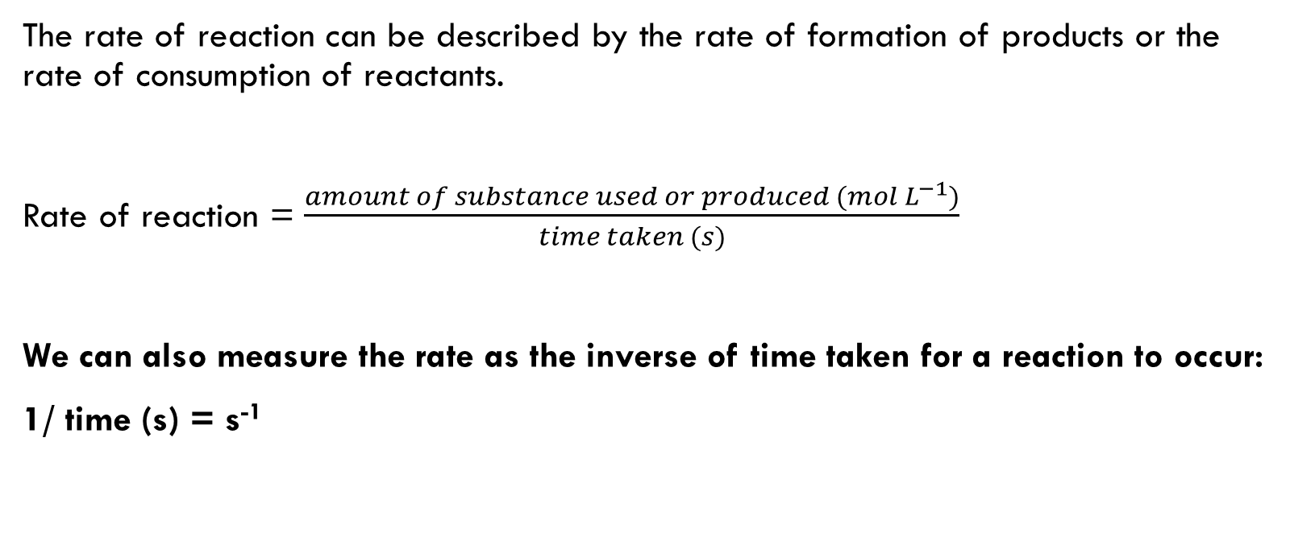
Reaction Rate
The rate of reaction can be described by the rate of formation of products or the rate of consumption of reactants.
Rate of reaction = $\frac{amount of substance used or produced ({mol L}^{−1})}{time taken (s)}$
We can also measure the rate as the inverse of time taken for a reaction to occur:
1/ time (s) = s⁻¹

